Slide 1
Predicting the Future Using Data Classification
UNIT 2

Slide 2
DATA CLASSIFICATION – PART I
Background
Exploring Data classification process
Using Data Classification to predict the future:
Decision tree
Algorithm for generating Decision Trees
Support Vector Machine.

Slide 3
OBJECTIVE
Introducing
Introducing data classification
Making
Making better decisions by using data classification
Getting
Getting an overview of widely used data classification algorithms
Using
Using data classification algorithms to predict future behavior of customers
Leveraging
Leveraging basic decision trees to assess business opportunities
Applying
Applying data classification as a way to make business predictions

Slide 4
What is Data Classification?
Data classification is a data-mining technique used to make sense of large and complex datasets.
It helps uncover hidden patterns and relationships in data.
This technique serves as a crucial first step in building predictive models.
In data mining, data classification is the process of labeling a data item as belonging to a class or category.
A data item is also referred to (in the datamining vocabulary) as data object, observation, or instance.

Slide 5
Classification Models
Predictive models that use data classification are known as classification models or classifiers.
These models use sophisticated machine-learning algorithms to learn from historical data and discover hidden patterns.
The ultimate goal is to predict outcomes based on newly input data.

Slide 6
Example - Risk Modelling
Financial institutions use classification algorithms for risk modelling.
Predict whether loans will be paid back, e.g., mortgage loans.
The classification model predicts the class or category of an event
Risky
not risky
moderately risky

Slide 7
EXAMPLE : The FICO Score
The FICO Score was introduced in 1989 by Fair, Isaac and Company (FICO).
It revolutionized the way lenders assess creditworthiness.
Factors That Determine Your FICO Score
Your FICO Score is calculated based on several key criteria:
Length of Credit History
Bill-Payment History
Types and Balances of Credit Cards
Recent Applications for Credit
The FICO Score Range
The FICO Score ranges between 300 and 850.
The higher the score, the lower the predicted credit risk.
A higher score indicates a higher likelihood of on-time loan repayment.

Slide 8
EXAMPLE : The FICO Score
Impact of a High FICO Score
What does a high FICO Score mean for you?
It translates to:
Higher chances of loan approval
More favourable loan terms
Lower interest rates
Access to premium financial products
Loan Approval and Your FICO Score
Explain how lenders use your FICO Score to make lending decisions.
Higher FICO Scores make you a more attractive borrower.
Lenders have greater confidence that you will repay the loan as agreed.

Slide 9
Data Classification vs. Data Clustering
Data Clustering:
Groups similar data elements based on inherent similarities.
Data Classification:
Predicts the category or group to which a new data object belongs.

Slide 10
Data Classification in Lending: Enhancing Loan Decision-Making
The Complexity of Loan Decision-Making
Highlight the complexity of assessing loan applications.
Loan officers need to make critical decisions about granting or denying loans.
Role of a Classifier
Introduce the concept of a classifier as an essential tool in loan decision-making.
Explain that a classifier is essentially an algorithm that assists in analysing loan application data.
Classifier's Decision-Making Process
Analyses information in the loan application.
References external sources of information on the applicant.
Labels the application as "safe," "too risky," or "safe with conditions."
Notes:
1. Loan Application Analysis:
Loan officers are tasked with the responsibility of assessing loan applications to determine whether an applicant should be approved or denied a loan.
This evaluation is a critical decision, as it involves the allocation of financial resources and carries inherent risks for the lending institution.
2. The Role of a Classifier:
To assist in making such significant decisions, loan officers can employ a classifier.
A classifier is essentially an algorithm, a set of programmed instructions, that instructs a computer on how to assess the information provided in a loan application.
The classifier can also reference external sources of information about the applicant, such as credit scores or employment history.
3. Categorizing Loan Applications:
Once the classifier processes the information, it categorizes the loan application into predefined classes or categories.
Common categories may include "safe," "too risky," or "safe with conditions."
4. Streamlining Decision-Making:
By utilizing a classifier, much of the decision-making process is automated, reducing the manual workload of the loan officer or underwriter.
Moreover, it mitigates the portfolio risk for the lending institution, contributing to a higher Return on Investment (ROI).
5. Conditional Approvals:
In some cases, the classifier may label an applicant as "safe with conditions."
When this happens, the loan processor or officer can request that the applicant fulfill specific conditions, such as providing additional collateral or co-signers, in order to secure the loan.
Once the conditions are met, the loan application can be reevaluated by the classifier for final approval.
6. Machine Learning for Ongoing Improvement:
Machine learning is often applied in this context, where the loan application classifier learns from past applications and continually adapts to changing circumstances.
It leverages historical data to identify patterns and predict the future behavior of loan applicants.
This dynamic approach allows financial institutions to make more informed lending decisions.
7. Past, Present, and Speedy Decision-Making:
Data classification in the loan approval process relies on both historical data (past behavior and repayment patterns) and current information (such as income, credit score, and employment status).
By integrating both past and current data, the decision-making process becomes more accurate and efficient.
Speed is a critical factor in the lending industry, and data classification enables faster loan approvals, benefiting both applicants and lending institutions.
In summary, the use of classifiers in loan application processing exemplifies the power of data classification in making complex and critical decisions. It not only streamlines the decision-making process but also enhances the overall efficiency and risk management of lending operations. Additionally, the application of machine learning ensures that the classifier continually evolves and improves, adapting to changing market conditions and borrower behaviors.
Regenerate

Slide 11
Data Classification in Lending: Enhancing Loan Decision-Making
Advantages of using a classifier in loan processing:
Reduces the human workload.
Mitigates the company's portfolio risk.
Increases return on investment (ROI).
how using a classifier can enhance ROI:
Allows employees to originate more loans efficiently.
Enables better pricing and resale of higher-quality loans.
The classifier handles cases labelled as "safe with conditions":
Loan processor/officer can request fulfilment of conditions.
Upon meeting conditions, the application can be revaluated for approval.
Notes:
1. Loan Application Analysis:
Loan officers are tasked with the responsibility of assessing loan applications to determine whether an applicant should be approved or denied a loan.
This evaluation is a critical decision, as it involves the allocation of financial resources and carries inherent risks for the lending institution.
2. The Role of a Classifier:
To assist in making such significant decisions, loan officers can employ a classifier.
A classifier is essentially an algorithm, a set of programmed instructions, that instructs a computer on how to assess the information provided in a loan application.
The classifier can also reference external sources of information about the applicant, such as credit scores or employment history.
3. Categorizing Loan Applications:
Once the classifier processes the information, it categorizes the loan application into predefined classes or categories.
Common categories may include "safe," "too risky," or "safe with conditions."
4. Streamlining Decision-Making:
By utilizing a classifier, much of the decision-making process is automated, reducing the manual workload of the loan officer or underwriter.
Moreover, it mitigates the portfolio risk for the lending institution, contributing to a higher Return on Investment (ROI).
5. Conditional Approvals:
In some cases, the classifier may label an applicant as "safe with conditions."
When this happens, the loan processor or officer can request that the applicant fulfill specific conditions, such as providing additional collateral or co-signers, in order to secure the loan.
Once the conditions are met, the loan application can be reevaluated by the classifier for final approval.
6. Machine Learning for Ongoing Improvement:
Machine learning is often applied in this context, where the loan application classifier learns from past applications and continually adapts to changing circumstances.
It leverages historical data to identify patterns and predict the future behavior of loan applicants.
This dynamic approach allows financial institutions to make more informed lending decisions.
7. Past, Present, and Speedy Decision-Making:
Data classification in the loan approval process relies on both historical data (past behavior and repayment patterns) and current information (such as income, credit score, and employment status).
By integrating both past and current data, the decision-making process becomes more accurate and efficient.
Speed is a critical factor in the lending industry, and data classification enables faster loan approvals, benefiting both applicants and lending institutions.
In summary, the use of classifiers in loan application processing exemplifies the power of data classification in making complex and critical decisions. It not only streamlines the decision-making process but also enhances the overall efficiency and risk management of lending operations. Additionally, the application of machine learning ensures that the classifier continually evolves and improves, adapting to changing market conditions and borrower behaviors.
Regenerate

Slide 12
Data Classification in Lending: Enhancing Loan Decision-Making
Machine Learning in Loan Classification
Learning from historical loan applications.
Leveraging current information in applications.
Predicting the future behaviour of loan applicants.
Predicting the Future
Emphasize that predicting the future involves learning from the past and evaluating the present.
Data classification relies on both past and current information to expedite decision-making.
Notes:
1. Loan Application Analysis:
Loan officers are tasked with the responsibility of assessing loan applications to determine whether an applicant should be approved or denied a loan.
This evaluation is a critical decision, as it involves the allocation of financial resources and carries inherent risks for the lending institution.
2. The Role of a Classifier:
To assist in making such significant decisions, loan officers can employ a classifier.
A classifier is essentially an algorithm, a set of programmed instructions, that instructs a computer on how to assess the information provided in a loan application.
The classifier can also reference external sources of information about the applicant, such as credit scores or employment history.
3. Categorizing Loan Applications:
Once the classifier processes the information, it categorizes the loan application into predefined classes or categories.
Common categories may include "safe," "too risky," or "safe with conditions."
4. Streamlining Decision-Making:
By utilizing a classifier, much of the decision-making process is automated, reducing the manual workload of the loan officer or underwriter.
Moreover, it mitigates the portfolio risk for the lending institution, contributing to a higher Return on Investment (ROI).
5. Conditional Approvals:
In some cases, the classifier may label an applicant as "safe with conditions."
When this happens, the loan processor or officer can request that the applicant fulfill specific conditions, such as providing additional collateral or co-signers, in order to secure the loan.
Once the conditions are met, the loan application can be reevaluated by the classifier for final approval.
6. Machine Learning for Ongoing Improvement:
Machine learning is often applied in this context, where the loan application classifier learns from past applications and continually adapts to changing circumstances.
It leverages historical data to identify patterns and predict the future behavior of loan applicants.
This dynamic approach allows financial institutions to make more informed lending decisions.
7. Past, Present, and Speedy Decision-Making:
Data classification in the loan approval process relies on both historical data (past behavior and repayment patterns) and current information (such as income, credit score, and employment status).
By integrating both past and current data, the decision-making process becomes more accurate and efficient.
Speed is a critical factor in the lending industry, and data classification enables faster loan approvals, benefiting both applicants and lending institutions.
In summary, the use of classifiers in loan application processing exemplifies the power of data classification in making complex and critical decisions. It not only streamlines the decision-making process but also enhances the overall efficiency and risk management of lending operations. Additionally, the application of machine learning ensures that the classifier continually evolves and improves, adapting to changing market conditions and borrower behaviors.
Regenerate

Slide 13
Data Classification in Lending: Enhancing Loan Decision-Making
Data Privacy and Ethics
Handling sensitive applicant information responsibly.
Ensuring fairness in the classification process.
Challenges in Loan Classification
Data quality and consistency.
Regulatory compliance.
Bias in decision-making.
Future Trends
Explainable AI for transparent decisions.
Personalized loan recommendations.
Enhanced fraud detection.
Notes:
1. Loan Application Analysis:
Loan officers are tasked with the responsibility of assessing loan applications to determine whether an applicant should be approved or denied a loan.
This evaluation is a critical decision, as it involves the allocation of financial resources and carries inherent risks for the lending institution.
2. The Role of a Classifier:
To assist in making such significant decisions, loan officers can employ a classifier.
A classifier is essentially an algorithm, a set of programmed instructions, that instructs a computer on how to assess the information provided in a loan application.
The classifier can also reference external sources of information about the applicant, such as credit scores or employment history.
3. Categorizing Loan Applications:
Once the classifier processes the information, it categorizes the loan application into predefined classes or categories.
Common categories may include "safe," "too risky," or "safe with conditions."
4. Streamlining Decision-Making:
By utilizing a classifier, much of the decision-making process is automated, reducing the manual workload of the loan officer or underwriter.
Moreover, it mitigates the portfolio risk for the lending institution, contributing to a higher Return on Investment (ROI).
5. Conditional Approvals:
In some cases, the classifier may label an applicant as "safe with conditions."
When this happens, the loan processor or officer can request that the applicant fulfill specific conditions, such as providing additional collateral or co-signers, in order to secure the loan.
Once the conditions are met, the loan application can be reevaluated by the classifier for final approval.
6. Machine Learning for Ongoing Improvement:
Machine learning is often applied in this context, where the loan application classifier learns from past applications and continually adapts to changing circumstances.
It leverages historical data to identify patterns and predict the future behavior of loan applicants.
This dynamic approach allows financial institutions to make more informed lending decisions.
7. Past, Present, and Speedy Decision-Making:
Data classification in the loan approval process relies on both historical data (past behavior and repayment patterns) and current information (such as income, credit score, and employment status).
By integrating both past and current data, the decision-making process becomes more accurate and efficient.
Speed is a critical factor in the lending industry, and data classification enables faster loan approvals, benefiting both applicants and lending institutions.
In summary, the use of classifiers in loan application processing exemplifies the power of data classification in making complex and critical decisions. It not only streamlines the decision-making process but also enhances the overall efficiency and risk management of lending operations. Additionally, the application of machine learning ensures that the classifier continually evolves and improves, adapting to changing market conditions and borrower behaviors.
Regenerate

Slide 14

Exploring the Data-Classification Process

Slide 15
Key Stages of Data Classification
Learning Stage:
Training the classification model with historical data.
Prediction Stage:
Using the model to predict new data.

Slide 16
Learning Stage
Train the classification model using historical (training) data.
Objective: Teach the model to uncover hidden relationships and classification rules.
Achieved through the application of a classification algorithm.
Notes:
The learning stage of data classification is a fundamental aspect of machine learning and data analysis. It refers to the process through which a classification model, such as a decision tree, support vector machine, or neural network, learns from existing data in order to make predictions or decisions about new, unseen data. This stage involves several key steps:
1. Data Collection:
The learning process begins with the collection of labeled training data. This data consists of examples where each example is associated with a known category or class label.
For instance, in a spam email classification task, the training data would consist of a large dataset of emails, each labeled as either "spam" or "not spam."
2. Data Preprocessing:
Once the data is collected, it often requires preprocessing to clean, transform, and prepare it for analysis. This may involve tasks like removing duplicates, handling missing values, and normalizing data.
3. Feature Selection/Engineering:
Features are the attributes or characteristics of the data that are used to make predictions. Feature selection or engineering involves identifying the most relevant features and creating new ones if necessary.
In text classification, for example, features might be the frequency of specific words or phrases.
4. Model Selection:
The next step is to choose an appropriate classification model. This depends on the nature of the data and the problem you're trying to solve.
Common classification algorithms include decision trees, logistic regression, support vector machines, and neural networks.
5. Training the Model:
Training involves feeding the labeled training data into the chosen model so that it can learn the relationships between the features and the class labels.
During this process, the model adjusts its internal parameters to minimize the error or loss function, which quantifies how well the model's predictions match the true labels in the training data.
6. Model Evaluation:
After training, the model's performance is evaluated using a separate dataset called the validation or test set. This set contains examples with known labels that the model has never seen before.
Common evaluation metrics include accuracy, precision, recall, F1 score, and ROC curves, depending on the nature of the classification task.
7. Fine-Tuning:
Depending on the evaluation results, the model may undergo further refinement, such as hyperparameter tuning, to improve its performance.
Hyperparameters are settings that are not learned from the data but are set prior to training, such as the learning rate in neural networks.
8. Deployment:
Once the model achieves satisfactory performance on the validation or test set, it can be deployed for making predictions or classifying new, unseen data.
Deployment can involve integrating the model into an application, system, or pipeline where it can provide real-time or batch predictions.
9. Monitoring and Maintenance:
After deployment, it's essential to monitor the model's performance over time and update it as needed to ensure it remains accurate and relevant as new data becomes available.
In summary, the learning stage of data classification involves collecting and preprocessing labeled data, selecting and training a classification model, evaluating its performance, and deploying it for making predictions. This iterative process is at the core of machine learning and is used to build models that can automatically categorize or classify data based on patterns learned from historical data.

Slide 17
Prediction Stage
Deploy the model to predict class labels or numerical values for new, unseen data (test data).
This stage follows the learning stage and assesses the model's accuracy.
Notes:
The prediction stage of data classification is the phase where a trained classification model is applied to new, unseen data to make predictions or categorizations. This stage is crucial for utilizing the knowledge and patterns learned during the model training phase to classify real-world instances. Here's a detailed explanation of the prediction stage:
1. Data Input:
In the prediction stage, the model takes as input one or more data instances that need to be classified. These instances are often referred to as "test data" or "unseen data."
2. Preprocessing (if necessary):
Just like in the training stage, the incoming data may require preprocessing steps to be prepared for classification. This could include tasks such as cleaning, normalization, and feature extraction.
3. Feature Extraction (if necessary):
If the model requires specific features for prediction, feature extraction might be necessary to transform the input data into a format that the model can understand.
4. Applying the Trained Model:
The core of the prediction stage involves applying the trained classification model to the preprocessed data. The model uses the relationships and patterns it learned during training to make predictions.
5. Generating Predictions:
The model outputs predictions or class labels for the input data instances. The format of these predictions depends on the problem type:
For binary classification, the output might be "positive" or "negative," "yes" or "no," or similar binary labels.
For multi-class classification, the model predicts one of several possible classes.
For regression (a related task), the model predicts a continuous value.
6. Confidence Scores (Optional):
In some cases, the model might provide confidence scores or probabilities associated with each prediction. This indicates the level of confidence the model has in its predictions.
7. Post-Processing (if necessary):
Depending on the application, post-processing steps may be required to interpret or act upon the model's predictions. For example, in a medical diagnosis system, predictions might be post-processed to provide additional context or recommendations.
8. Decision-Making and Action:
Once the predictions are generated, they can be used for decision-making or taking actions. This could include approving or denying a loan application, categorizing emails as spam or not, or recommending products to customers.
9. Evaluation (Optional):
In some cases, the model's predictions may be evaluated on the new data to assess its performance. This is often done when the true labels for the test data are known (e.g., in a validation set).
10. Feedback Loop (Optional):
If the model's predictions are used in an ongoing process, there may be a feedback loop where the model's performance is continually monitored, and the model may be retrained or fine-tuned periodically to adapt to changing data patterns.
11. Reporting and Visualization (Optional):
The results of the predictions can be reported and visualized as needed, providing insights and information to stakeholders or decision-makers.
In summary, the prediction stage of data classification is where the trained model is applied to new data to make predictions or decisions based on the patterns it has learned. This stage is integral to many machine learning applications, enabling automated classification, categorization, and decision-making in various domains, from finance to healthcare to natural language processing.

Slide 18
EXAMPLE: Online Watch Store
Feasibility and value of acquiring third-party data:
Companies that track and sell valuable customer information.
Utilizing data from social media platforms and applying data-mining techniques.
Analyzing Customer Interest- how text-analytics tools can gauge customer interest:
Analyzing social network profiles, tweets, blog posts, and other textual data.
Measuring an individual's level of interest in watches.
Data Organization
Structuring data for easy access and utilization, such as creating a database.

Slide 19
EXAMPLE: Online Watch Store
The Prediction Stage
Testing the model's accuracy and the classification rules it generated.
Using historical customer data, referred to as test data, distinct from training data.
Measuring Accuracy
Counting correct predictions of future customer behavior.
Identifying instances where the model made incorrect predictions.
Two Possible Outcomes
Satisfied with accuracy: Proceed to integrate the model into production.
Dissatisfied with accuracy: Retrain the model with a new training dataset.
Addressing Model Challenges
Non-representative training data.
Noisy data leading to inaccurate predictions.

Slide 20

Using Data Classification to Predict the Future

Slide 21
Description of Decision Rules or Trees
Intuitive appeal for users
Presentation Forms
“if, then” statements (decision rules)
graphically - decision trees

Slide 22
Decision tree
a simple classification technique the decision tree classifier.
Classification Problem:
Consider the example of distinguishing mammals from non-mammals using a dataset of vertebrate species.
Asking Questions: Decision trees work by posing a series of questions about the attributes of a data point (in this case, a species). Each question helps narrow down the possibilities until a definitive class label can be assigned.
Hierarchy of Questions: These questions and their possible answers are organized into a hierarchical structure called a decision tree.

Slide 23
Decision tree
Types of Nodes in a Decision Tree:
Root Node: The starting point of the tree with no incoming links and multiple outgoing links.
Internal Nodes: These nodes have one incoming link and two or more outgoing links. They represent attribute test conditions.
Leaf Nodes: Terminal nodes with one incoming link and no outgoing links. They are associated with a class label.
Attribute Test Conditions:
Non-terminal nodes (root and internal nodes) contain attribute test conditions, typically defined using a single attribute. Each outcome of the test condition leads to one of the child nodes.
Classifying with a Decision Tree:
To classify a new data point (e.g., a new species), start at the root node, apply the attribute test condition, and follow the appropriate branch based on the outcome of the test. Continue this process until a leaf node is reached, and assign the class label associated with that leaf node to the data point.

Slide 24
What They Look Like
Works like a flow chart
Looks like an upside-down tree
Nodes
appear as rectangles or circles
represent test or decision
Lines or branches - represent outcome of a test
Circles - terminal (leaf) nodes
Top or starting node- root node
Internal nodes - rectangles

Slide 25
QUESTION ?
Draw the full decision tree for the parity function of four Boolean attributes, A, B, C, and D. Is it possible to simplify the tree?

Slide 26
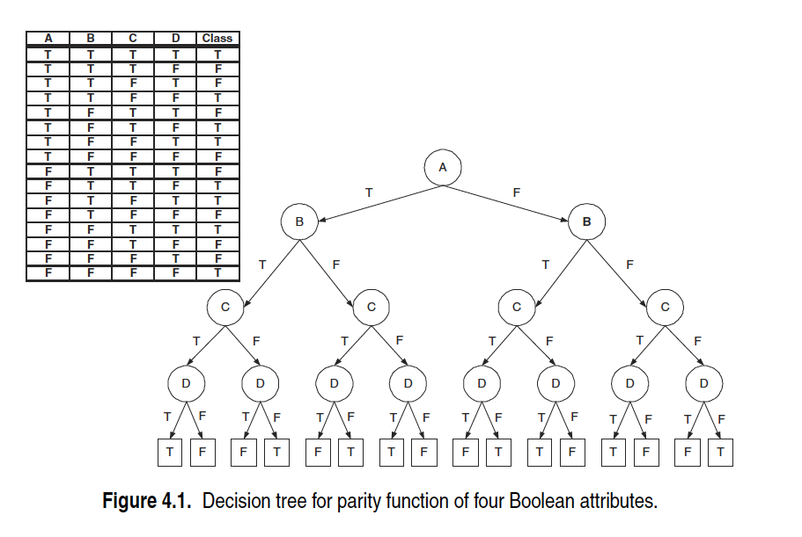

Slide 27
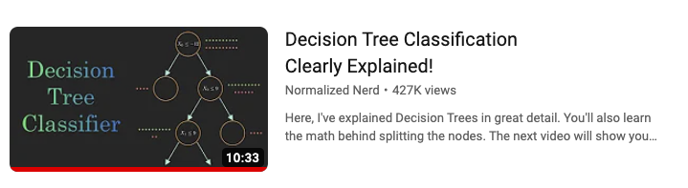
Video for Decision Tree classifier
https://youtu.be/ZVR2Way4nwQ?si=3BCEgiUm_HNzlm83

Slide 28
Example: Vertebrate Classification
Classifying vertebrates into mammals, reptiles, birds, fishes, and amphibians.
The attribute set includes characteristics of the vertebrate such as its body temperature, skin cover, and ability to fly.
The data set can also be used for a binary classification task
Mammal classification, by grouping the reptiles, birds, fishes, and amphibians into a single category called nonmammals.

Slide 29
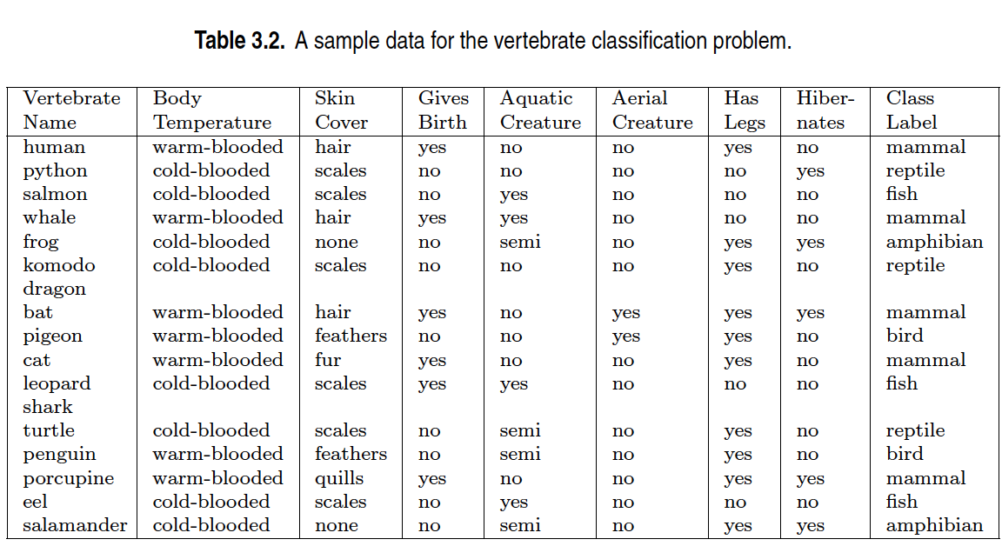

Slide 30
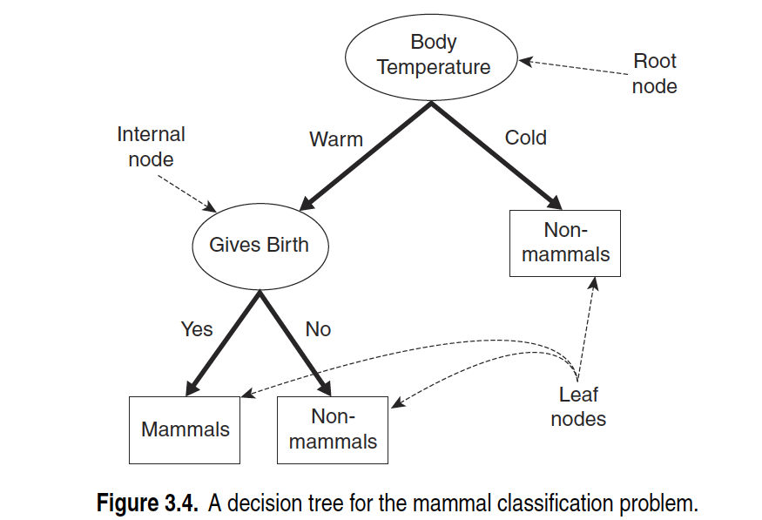

Slide 31
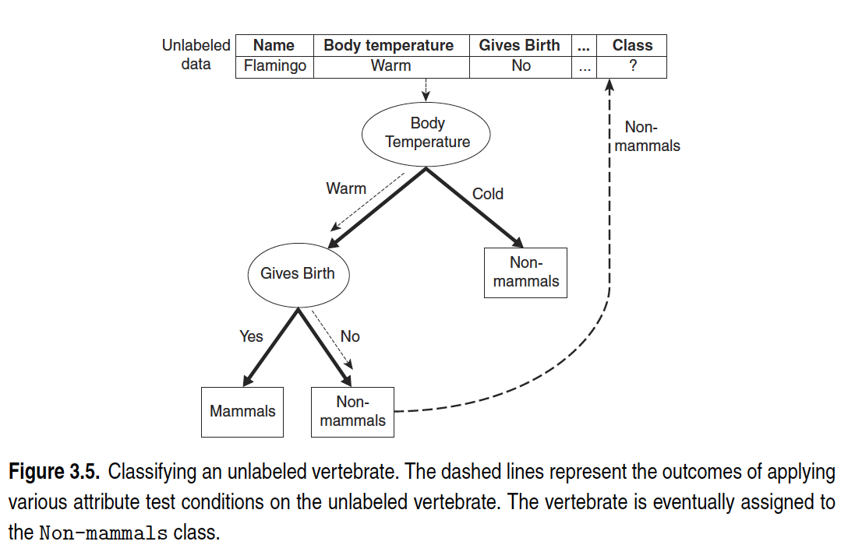

Slide 32
Example Decision Tree
A decision tree predicts whether a customer will buy a watch at the online store.
Nodes represent attributes like customer interest, age, and salary.
Applying the Model
For Customer X, follow the path from the root to a leaf (yes or no) to predict their behaviour.
Each node of the decision tree represents an attribute identified in the data matrix.
The leaves of the tree are the predicted decisions, as shown in Figure 7-2..

Slide 33
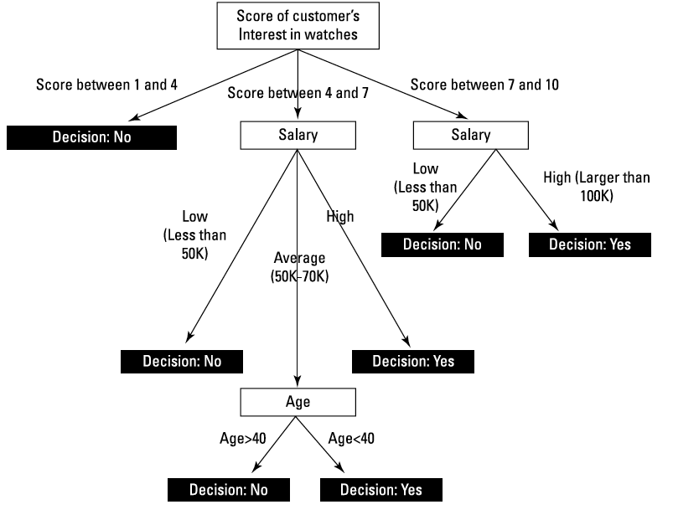

Slide 34
DECISION TREE INDUCTION ALGORITHM
Hunt’s Algorithm:
it serves as a basis for some of the more complex algorithms.
CART (Classification and regression trees)
a non-parametric technique, uses the Gini index to select attribute for 1st split
ID3, C4.5:
Picks the attribute with the highest reduction in entropy to determine which attribute should the data be split with first
SLIQ, SPRINT
Scalable algorithms that have been proposed to deal with the issues the greedy algorithms above present

Slide 35
Hunt’s Algorithm
a decision tree algorithm that builds a decision tree by partitioning a training dataset into increasingly pure subsets.
In a top-down, recursive manner
It follows a greedy approach to partition the training data based on attribute tests.

Slide 36
Steps in hunt’s algo
Initialization
Start with a single root node that represents all the training instances.
Check for Homogeneity:
If all the training instances at a node belong to the same class
create a leaf node for that class and stop expanding this branch
Attribute Selection:
If the training instances at a node belong to multiple classes, select an attribute to split the data.
This attribute selection is often based on a splitting criterion like information gain (used in ID3), gain ratio (used in C4.5), or Gini impurity (used in CART).
The attribute that best separates the instances into different classes is chosen for splitting.

Slide 37
Steps in hunt’s algo
Splitting:
Create child nodes for each possible outcome of the selected attribute.
Instances are distributed to these child nodes based on their attribute values.
Continue the recursive expansion of the tree for each child node, considering only the instances associated with that node.
Stopping Criteria:
The recursion stops when one of the following conditions is met
All instances at a node belong to the same class, and a pure leaf node is created.
No further attributes are available for splitting (e.g., all attributes have been used, or the depth limit of the tree is reached).
A predefined stopping criterion is met (e.g., a minimum number of instances at a node or a minimum information gain threshold).
Assigning Class Labels:
When the recursion stops for a particular branch, a class label is assigned to each leaf node.
The label is determined based on the majority class of the training instances associated with that node.

Slide 38
Hunt’s algo
X_{t} : the set of training records for node t
y={y₁ ,…,y_{c} }: class labels
Step 1: If all records in X_{t} belong to the same class y_{t} , then t is a leaf node labeled as y_{t}
Step 2: If X_{t} contains records that belong to more than one class,
select attribute test condition to partition the records into smaller subsets
Create a child node for each outcome of test condition
Apply algorithm recursively for each child

Slide 39
Example- Hunt’s Algo
Initial Leaf Node (Figure 3.6(a)):
The tree starts with a single leaf node, and it is labeled as "Defaulted = No" because it represents the majority class in the training data. The training error of this initial tree is 30% because three out of ten training instances have the class label "Defaulted = Yes."
Since the leaf node contains instances from more than one class, it is not pure and can be further expanded.
Attribute Selection (Choosing "Home Owner"):
The algorithm selects the "Home Owner" attribute as the attribute to split the training instances. The specific criteria for choosing this attribute are not provided in the description but might be based on information gain, gain ratio, or another criterion.
Binary Split on "Home Owner" (Figure 3.6(b)):
The "Home Owner" attribute is used to split the training data into two subsets. Instances with "Home Owner = Yes" go to the left child of the root node, while the rest go to the right child.
Recursive Expansion:
For the left child, all instances have "Home Owner = Yes," and since this subset is pure (all instances have the same class label, "Defaulted = No"), a leaf node labeled "Defaulted = No" is created, and no further splitting is required.
For the right child, it contains instances from both class labels, so further splitting is needed. The specific attribute and criteria for the next split are not provided in the description, but the algorithm continues to recursively expand this branch to create additional nodes and leaf nodes until certain stopping criteria are met.

Slide 40
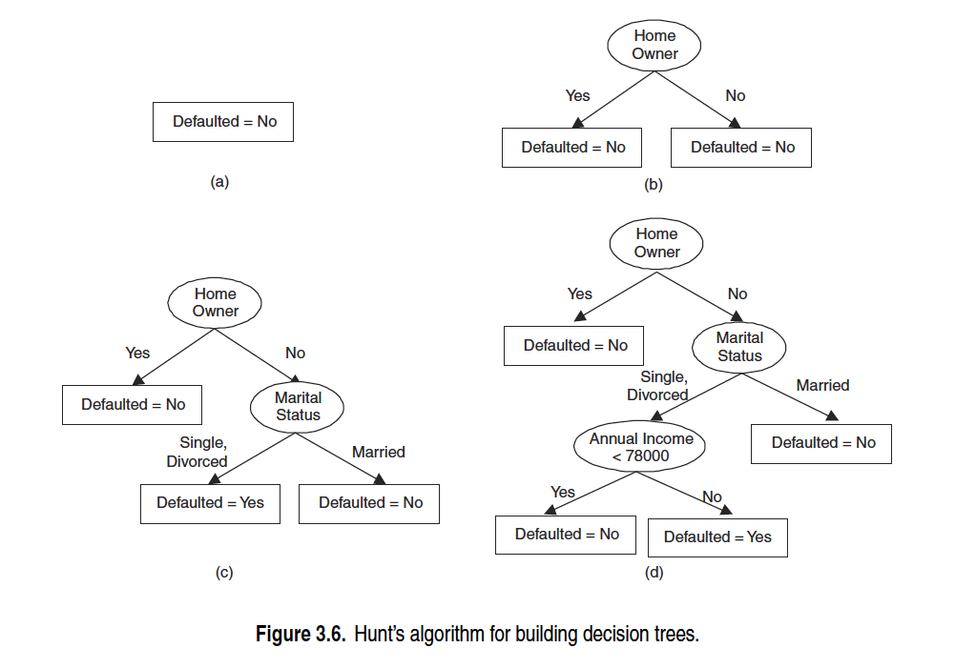

Slide 41
Assumptions made in Hunt's algorithm and how to handle them
Empty Child Nodes:
If a child node has no training instances due to a particular attribute value not being present in the dataset, you can treat it as a leaf node.
Assign the class label that is most frequent among the instances of the parent node.
This way, you maintain the structure of the tree and ensure that the decision tree covers all possible attribute values.
Identical Attribute Values, Different Class Labels:
When all training instances at a node have identical attribute values but different class labels, you can handle this by creating a leaf node for that subset.
Assign the class label that is most frequent among the instances at that node.
This ensures that the tree provides a prediction based on the most common class within that subset.

Slide 42

Support vector machine
The support vector machine (SVM) is a data-classification algorithm that assigns new data elements to one of labelled categories
Binary Classification vs. Multiclass SVM:
SVM is primarily a binary classifier, which means it is designed to classify data into two distinct categories or classes.
A multiclass SVM is an extension that allows SVM to be used as a classifier on datasets containing more than two classes or categories

Slide 43
Applications of SVM
image recognition
medical diagnosis,
text analytics.

Slide 44
Example: Image Recognition
Recognizing the type of fruit (apple or pear) in pictures.
The learning step involves training the SVM classifier with 200 pictures of apples and 200 pictures of pears.
These images are transformed into data matrices to be used as input for the SVM algorithm.
Representation of Images:
To represent an image as a matrix of numbers, various methods can be used, such as identifying geometric forms (e.g., circles, lines, squares) and their positions in the image.
This representation is critical for SVM to work with image data.
SVM Inputs:
Previous (Training) Data: A set of matrices representing previously seen images of apples and pears used for training the SVM.
New (Unseen) Data: An image converted into a matrix that needs to be classified (predicting whether it's an apple or a pear).

Slide 45
Example: Image Recognition
Kernel Function:
SVM uses a mathematical function known as a kernel function to match the new data (image) to the best image from the training data.
This matching process helps predict the label of the unknown picture (i.e., whether it's an apple or a pear).
SVM Characteristics:
SVM is known for producing robust and accurate predictions.
It is less affected by noisy data, making it suitable for real-world scenarios.
SVM is less prone to overfitting, which is a common problem in machine learning.
Binary Classification:
SVM is most suitable for binary classification problems, where there are only two categories or classes (e.g., apple or pear).

Slide 46

Video to explain SVM
https://youtu.be/_YPScrckx28?si=RlKd_yhQ_mDUlUzv

